Slide 1
ELEC3844 Engineering Management and Society Decision making tool PESTEL Analysis
Dr. Wilton Fok

Slide 2
PESTEL Analysis
PESTEL is an acronym that stands for
Political,
Economical,
Social,
Technological,
Environmental and
Legal.
It is used by many international consultancies to describe an analysis that is used for determining the opportunities and risks of global expansion.

Slide 3
PESTEL Analysis
Political, Economical, Social, Technological, Environmental and Legal issues often differ domestically and even more so internationally.
As a company/organization may use PESTEL analysis to accompany their SWOT analysis.

Slide 4
PESTEL Analysis
The PESTEL analysis provides a strong framework used by global and multinational corporations to set the stage to develop specific tactics to mitigate the risks involved in executing their vision in unfamiliar environments.

Slide 5
PESTEL - Political
Political factors are basically to what degree the government intervenes in the economy, include areas such as
tax policy, e.g. special stamp duties
labour law, minimal wages…etc.
environmental law,
trade restrictions,
tariffs, and
political stability

Slide 6
PESTEL - Political
Merit goods
goods and services which the government wants to provide or be provided
Demerit goods or merit bads
those that the government does not want to be provided
Governments have great influence on the health, education, and infrastructure

Slide 7
PESTEL - Economic
Economic factors include
economic growth,
interest rates,
exchange rates
inflation rate…etc

Slide 8
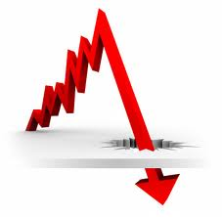
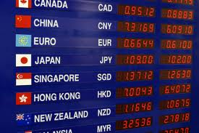
PESTEL - Economic
Major impacts on how businesses operate and make decisions.
E.g. 1. interest rates affect a firm's cost of capital and therefore to what extent a business grows and expands.
E.g. 2. Exchange rates affect the costs of exporting goods and the supply and price of imported goods in an economy

Slide 9
PESTEL - Social
Social factors include
Cultural aspects
health consciousness,
population growth rate,
age distribution,
career attitudes and
emphasis on safety.
Trends in social factors affect the demand for a company's products and how that company operates.

Slide 10
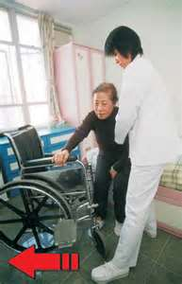

PESTEL - Social
E.g. an aging population may imply a smaller and less-willing workforce
→ increasing the cost of labor
More demand/opportunity on medical services

Slide 11


PESTEL - Social
E.g. companies may change various management strategies to adapt to these social trends, e.g.
Recruiting older workers
Develop new products of the elderly

Slide 12
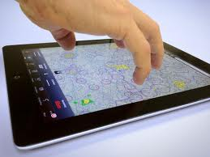
PESTEL - Technological
Technological factors include
R&D activity,
automation,
technology incentives and
the rate of technological change.
It determines barriers to:
Entry level
minimum efficient production level and
Influence outsourcing decisions.

Slide 13


PESTEL - Technological
Technological factors also affect
costs,
quality,
lead to innovation.

Slide 14
PESTEL - Environmental
Environmental factors include:
ecological and environmental aspects
weather,
climate, and
climate change…etc
It affects industries such as
tourism,
farming, and
insurance.

Slide 15
PESTEL - Environmental
What are the new markets?
Growing awareness of the potential impacts of climate change is affecting
how companies operate and
the products they offer,
creating new markets
diminishing or destroying existing ones
What markets were destroyed

Slide 16
PESTEL - Legal
Legal factors include:
discrimination law,
consumer law,
antitrust law,
employment law,
health and safety law.
Affect how a company operates, its costs, and the demand for its products.
e.g. the legal interpretation of permanent resident

Slide 17

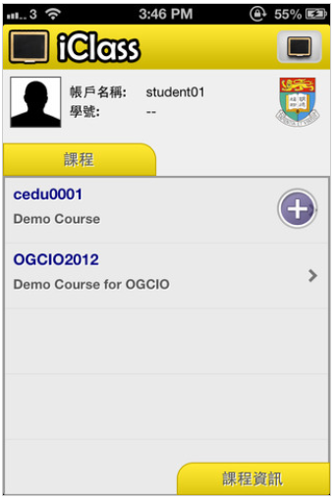

Use PESTEL analysis to discuss how any of these factor(s) may your business
For iPhone/iPad users:
Download and install “iClass Cloud” from Appstore
For other devices:
URL hku.iclass.hk
Login using your portal ID (Login through HKU Portal)
Join code: GR5182
Click on the question:
PESTEL Analysis
Click after entering the keywords

Slide 18


Applicability of the factors
The model's factors will vary in importance to a given company based on its industry and the goods it produces.
E.g., consumer and B2B companies tend to be more affected by the social factors

Slide 19
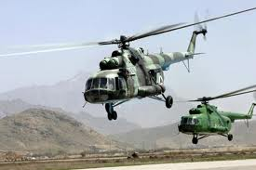
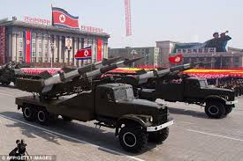
Applicability of the factors
E.g. a global defense contractor would tend to be more affected by political factors.

Slide 20


Applicability of the factors
Factors that are more likely to change in the future or more relevant to a given company will carry greater importance.
E.g. a company which has borrowed heavily will need to focus more on the economic factors (especially interest rates).

Slide 21
LONGPESTEL analysis
LONGPESTEL
PESTEL Analysis may also be divided into geographical relevance
LOcal
National
Global
Global
National
Local

